Slide 1
Hyperlynx SI modeling overview. Dmitry Vasilchenko
Where today meets tomorrow.
Restricted © Siemens 2022

Slide 2
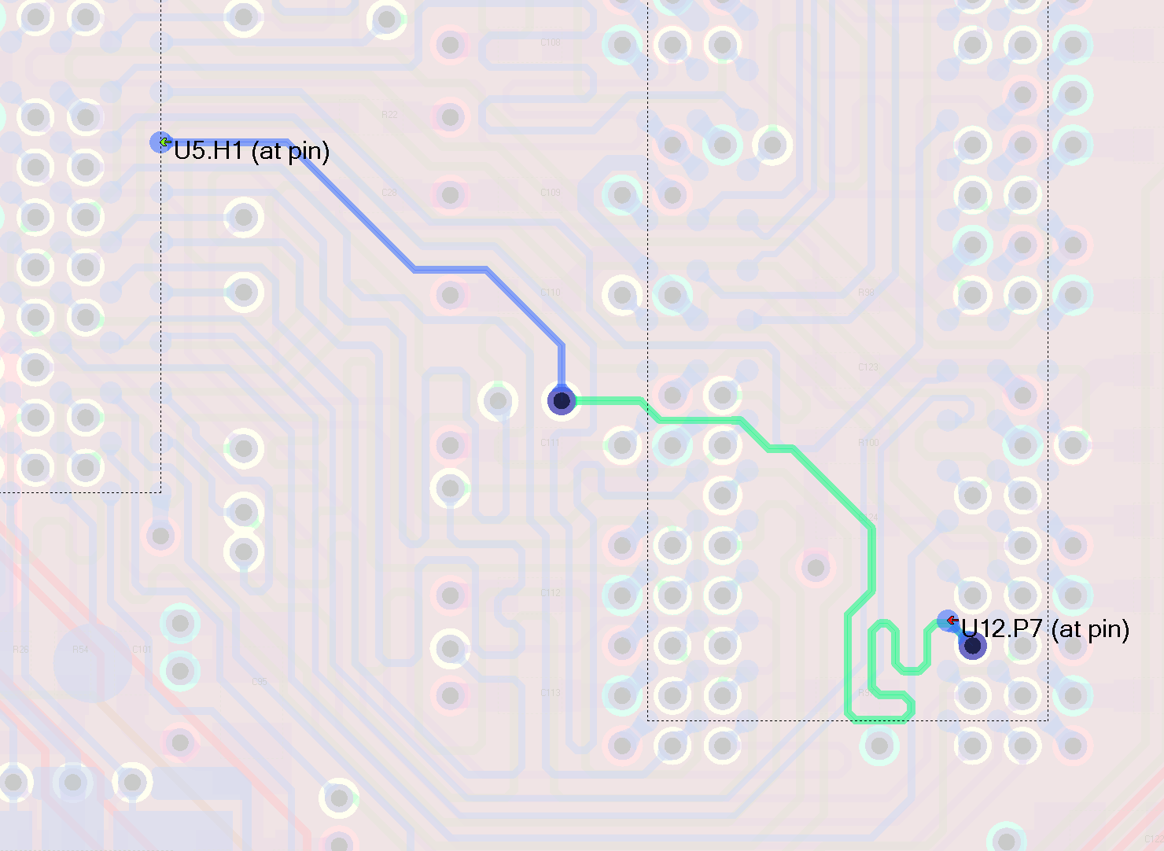
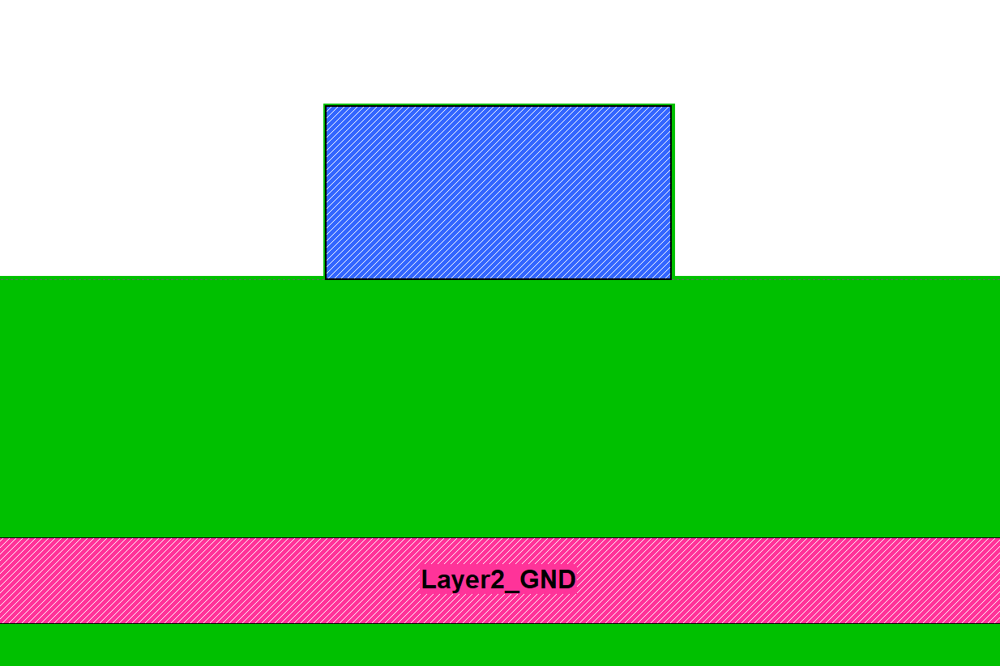
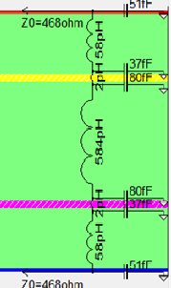
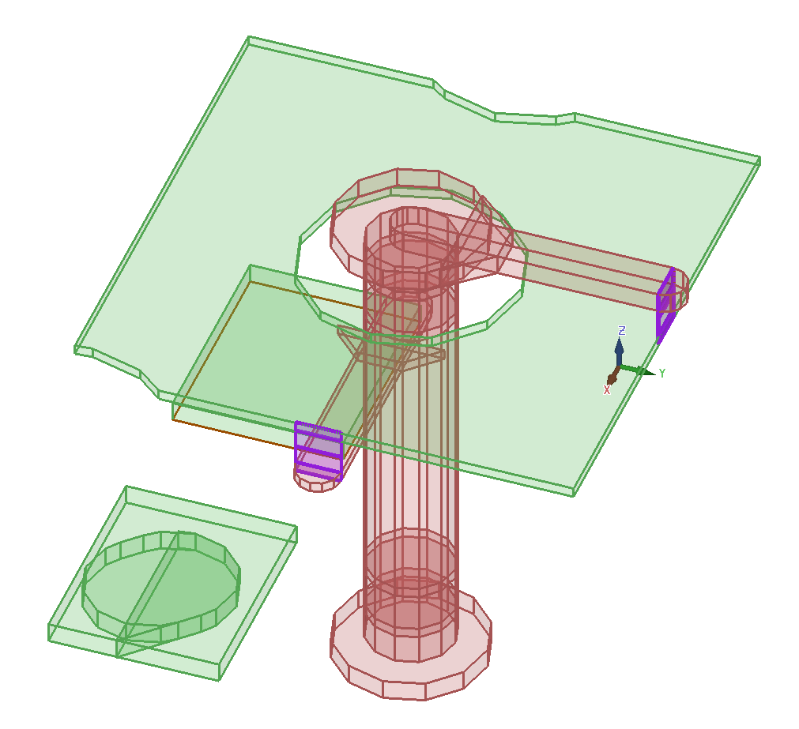
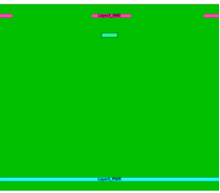
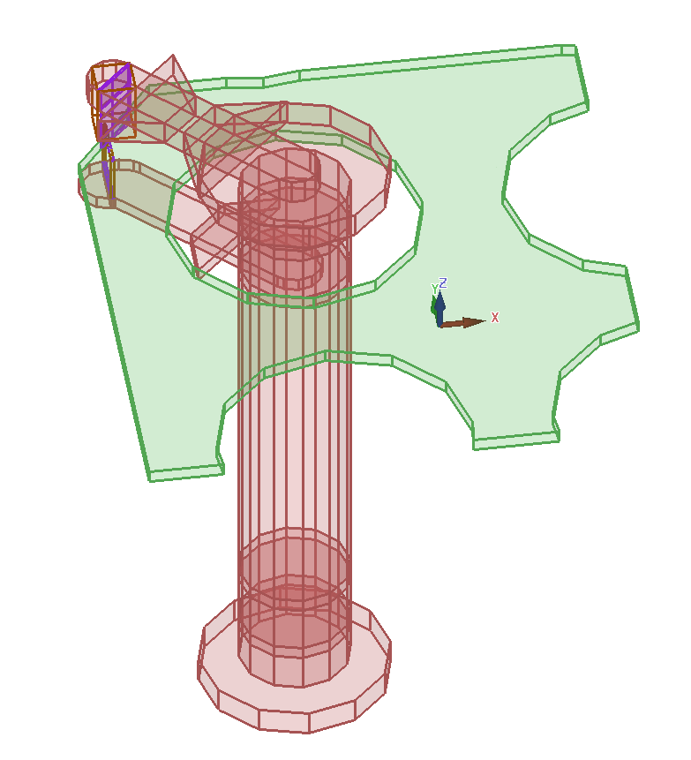
BoardSim net model extraction
Trace Modeler builds crossections, accounts for area fills, finds coupled nets
Via Modeler decompose via into sections

Slide 3
BoardSim SI simulation
Trace Modeler
Builds nGrpah with connected transmission lines and via/pin ports
Field Solver
Solves crossections for RLCG matrixes
Via Modeler
Lumped model, as LC chain (default)
Advanced via model as spice model
BoardSim does not directly support 3D via model, only via 3D areas
3D Area manager
Replaces insides of 3D area with a spice model from solved in HLAS
Model Builder
Loads IBIS, EBD and EMD models, finds switching coefficients k(t) for IBIS drivers
Netlister
Makes binary netlist basing on nGraph, Via Model, Model builder.
SimAPI
Runs simulator of choice (HyperSim, ADSM, HSPISE) for a given binary netlist
EZWave
WDB Server effectively handles waveforms for time domain simulation; EZwave viewer – displays waveforms

Slide 4
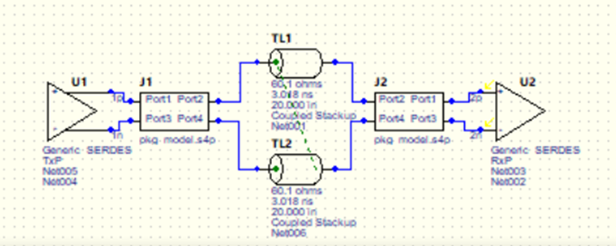
LineSim SI simulation
Field Solver
Solves t-lines for RLCG matrixes
Via Modeler
Lumped LC model (default)
Advanced via model
3D via model (native support)
Model Builder
Loads IBIS, EBD and EMD models, finds switching coefficients k(t) for IBIS drivers
FFS Netlister
Makes binary netlist basing on schematic symbols, Via Model, Model builder.
SimAPI
Runs simulator of choice (HyperSim, ADSM, HSPISE) for a given binary netlist
EZWave
WDB Server effectively handles waveforms for time domain simulation; EZwave viewer – displays waveforms

Slide 5
Eye diagram

Slide 6
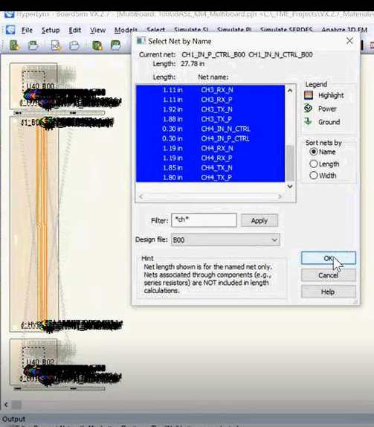
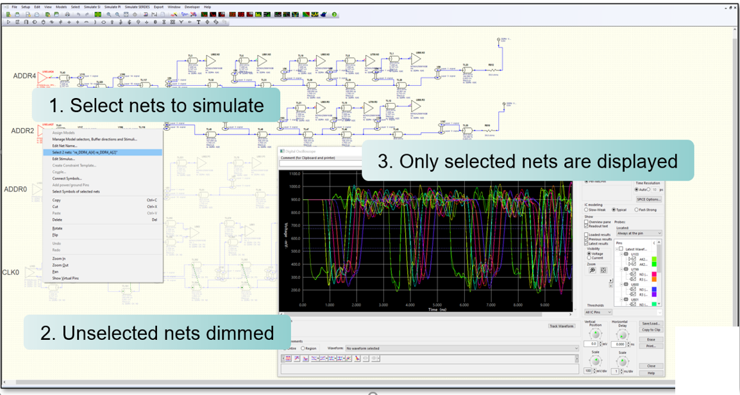
Multiple nets selection (to add: Manage assigned models dlg)

Slide 7
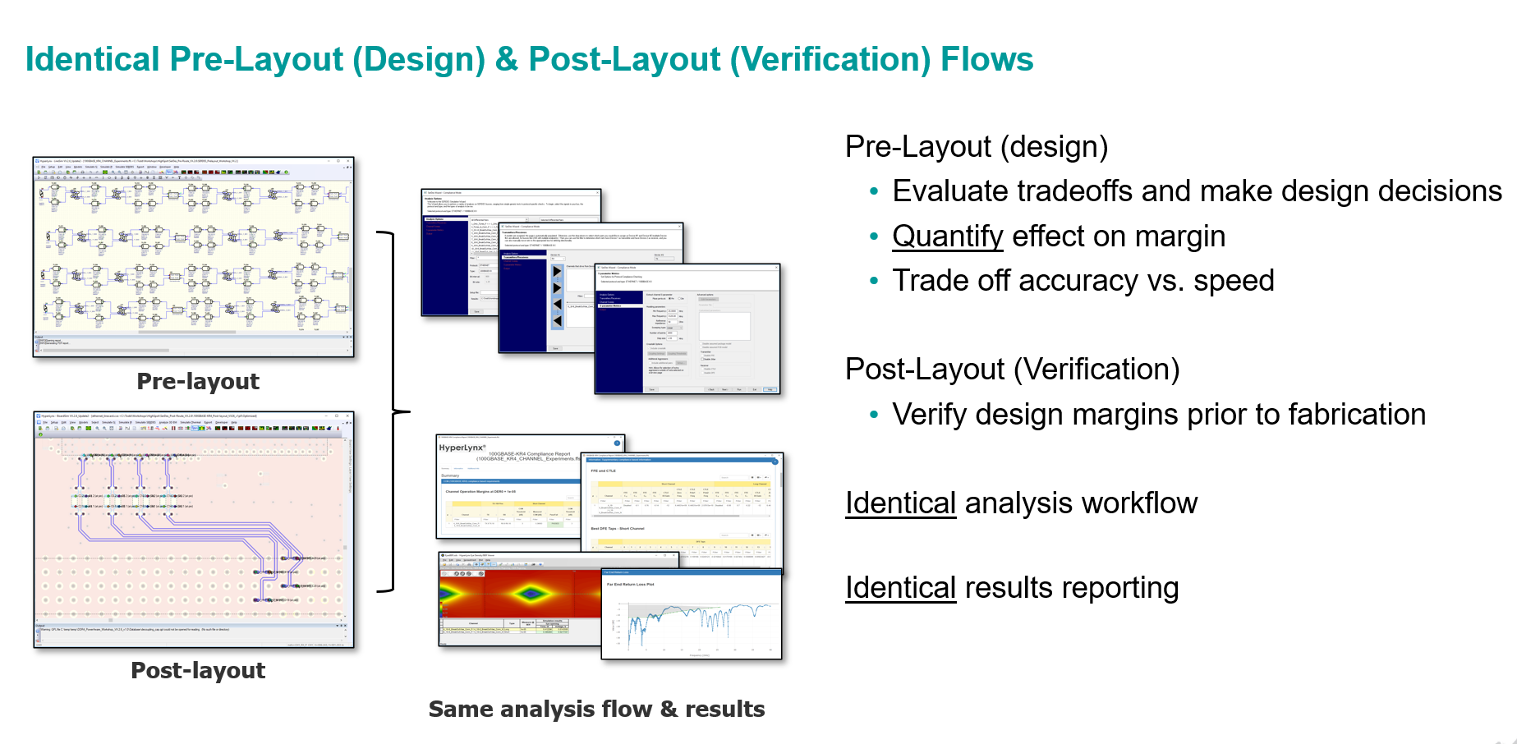
Summary

Slide 8
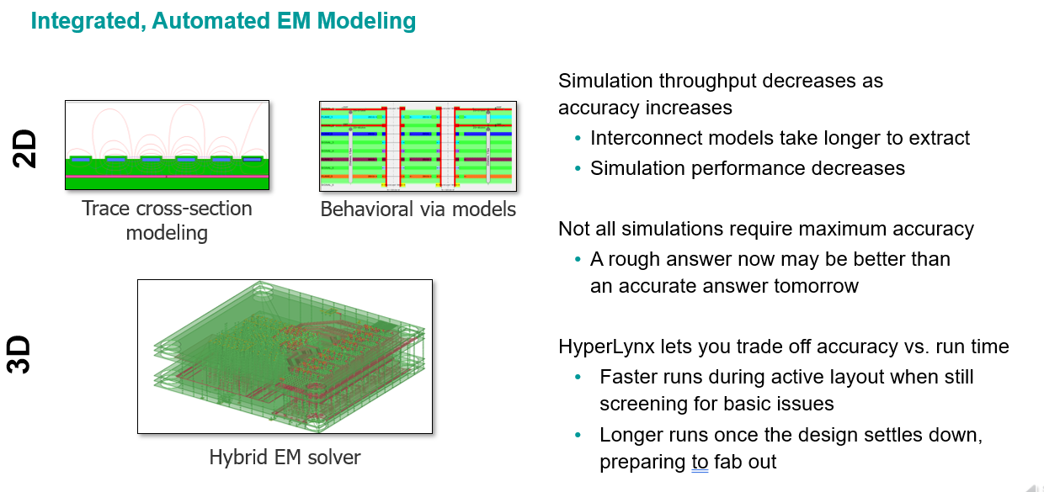
Summary

Slide 9
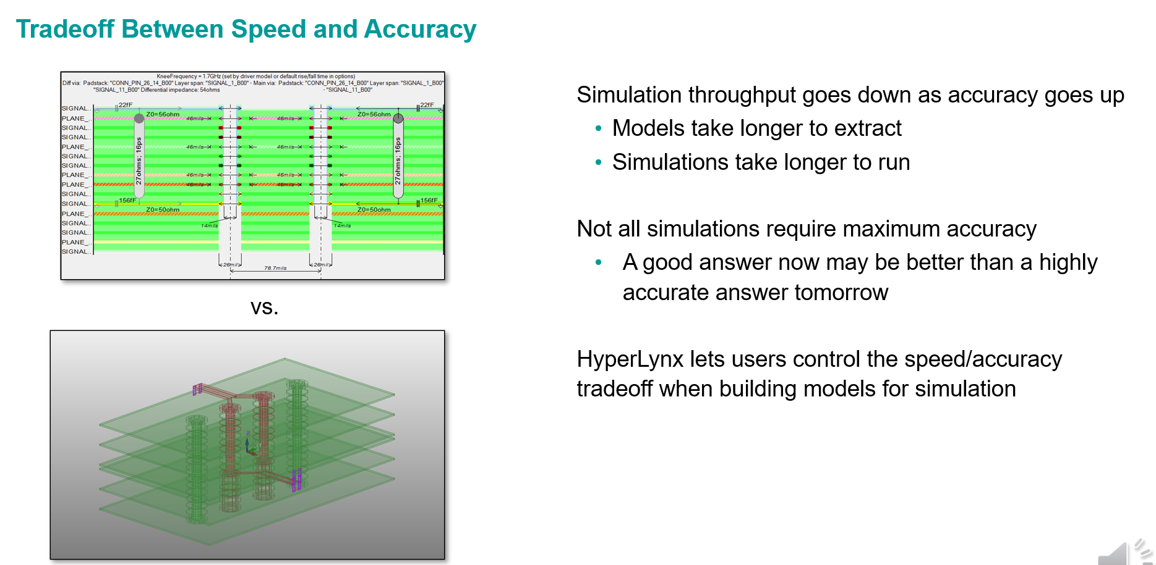
Via models

Slide 10
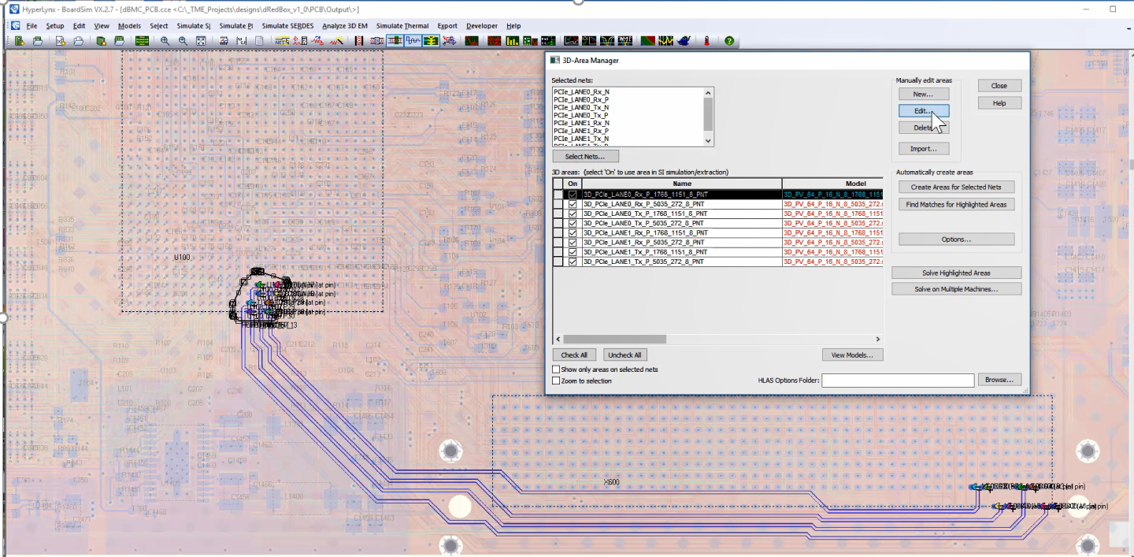
3D Area Manager

Slide 11
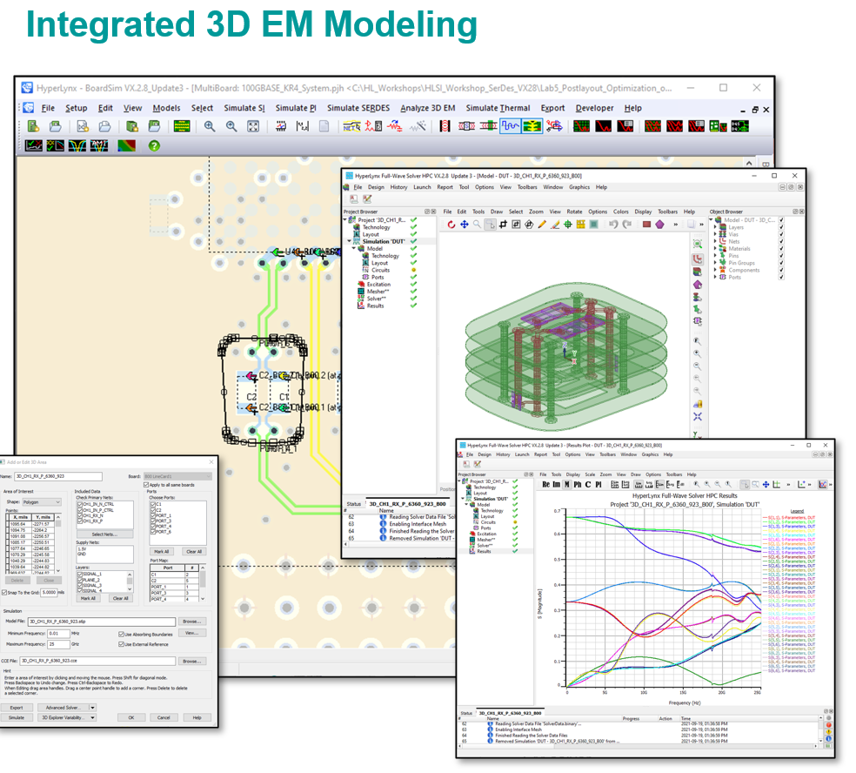
3D EM Modeling

Slide 12
Interactive SI simulations
Oscilloscope or EZwave flows
Traditionally, HL customers prefer Oscilloscope.
EZwave is more complex but powerful. It includes waveform calculator, various types of view, annotations, can handle huge waveforms.
Though all this is overkill if all you do is comparing RX waveforms for two consecutive simulations.
EZWave with measurements
Interactive DDR5 simulation

Slide 13
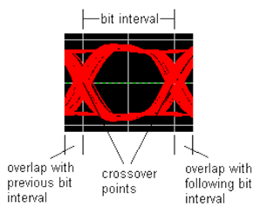
How to assess signal quality
Traditional SI measurements based on Vinh, Vinl switching thresholds.
Usually applied for a couple of pulses, originally just for the rising/falling edge. Used mostly to check slow switching signals with no jitter, no ISI, etc.
Min/Max delay
Static overshoot, Dynamic overshoot, Ringback, Monotonicity
Crosstalk
Constraints are defined per Net or Net Class in BoardSim.
Eye diagram / eye mask – for a long series of bits
Includes jitter, ISI

Slide 14
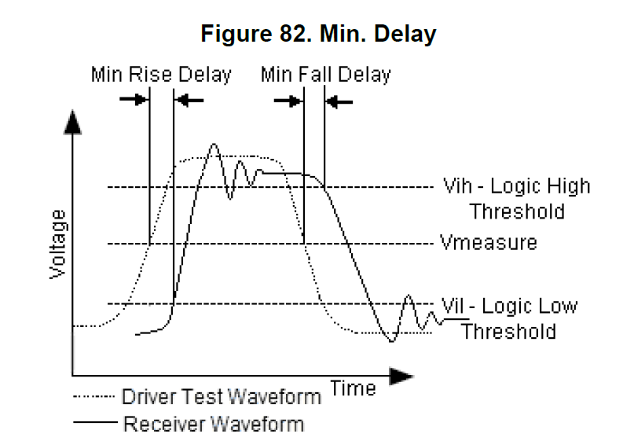
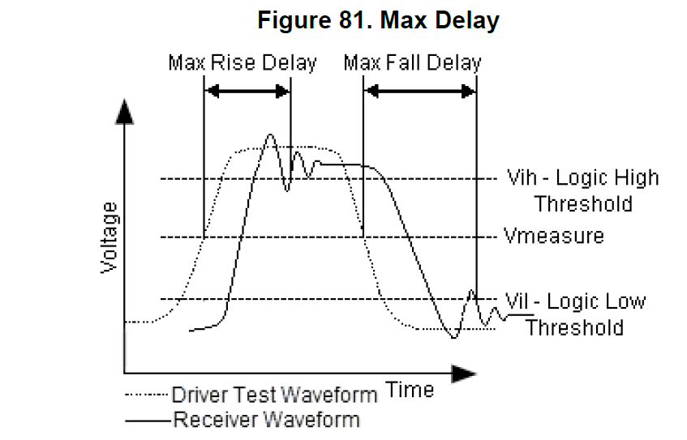
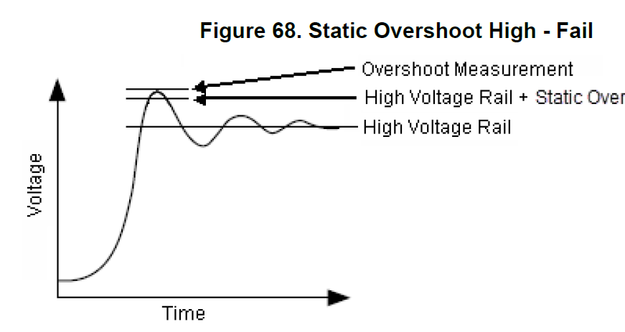
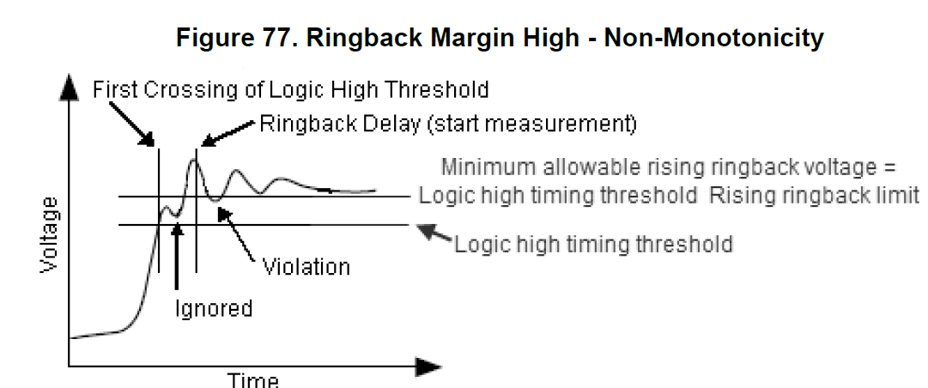
Traditional SI measurements

Slide 15
Summary

Slide 16
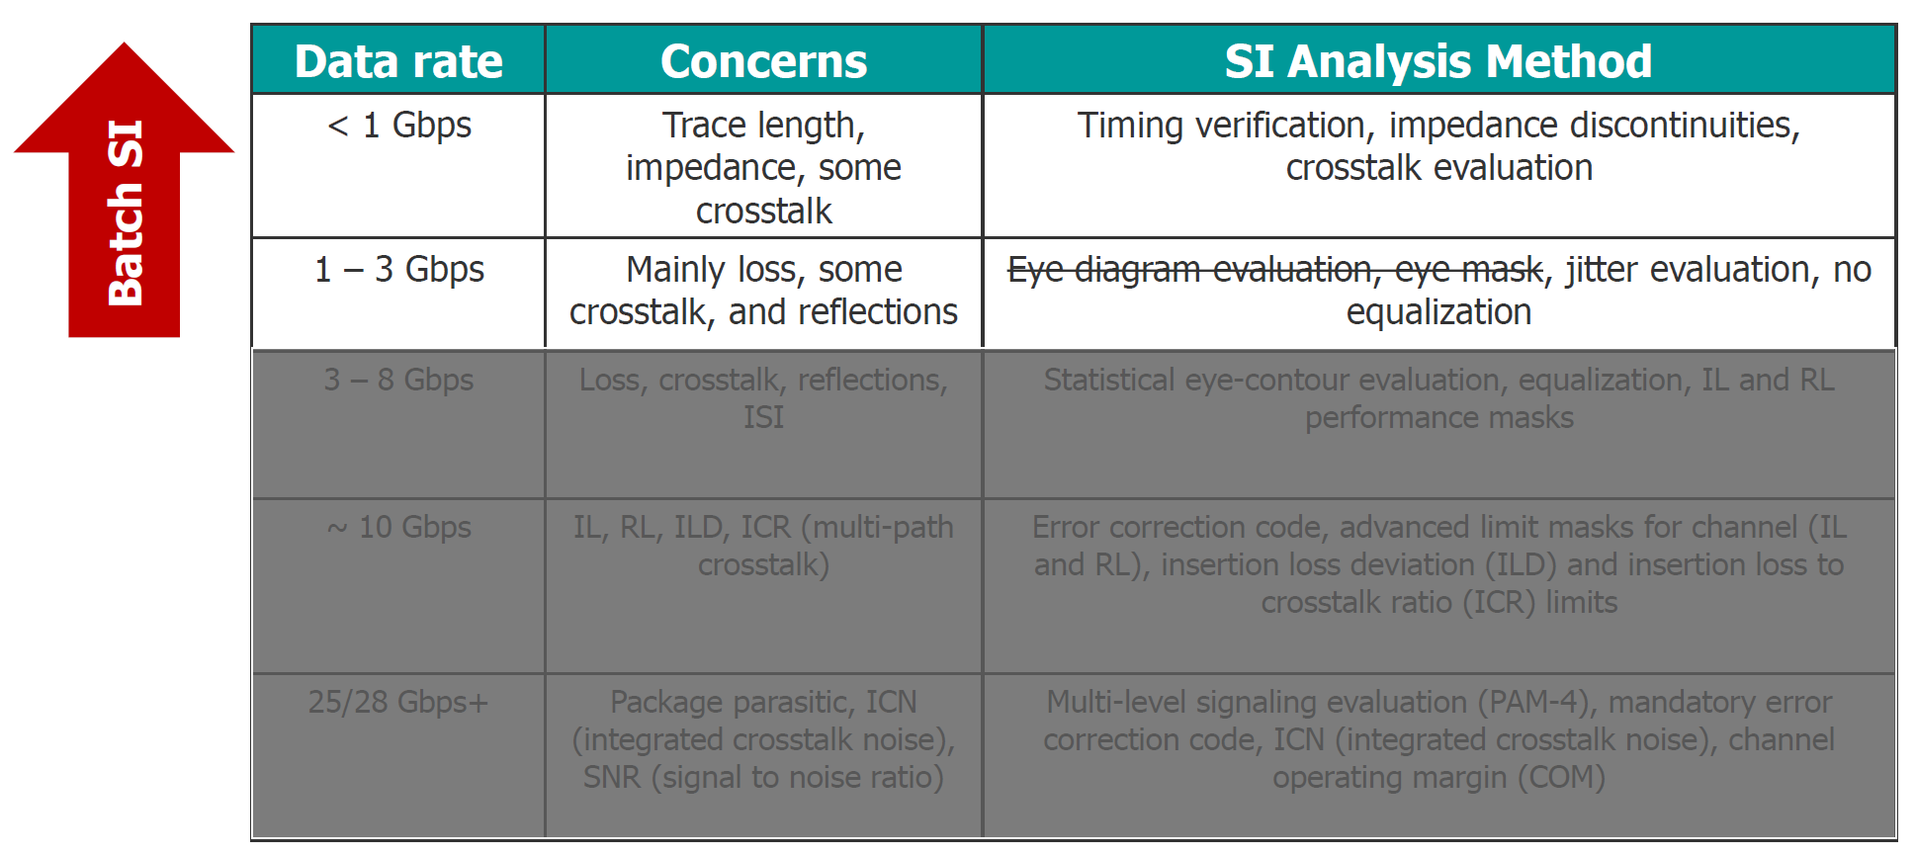
SI concerns for different data rate

Slide 17
Batch analysis
General Batch Wizard
Pulse Respond Wizard
DDRx Wizard
SerDes Wizard
Includes old FastEye Wizard

Slide 18
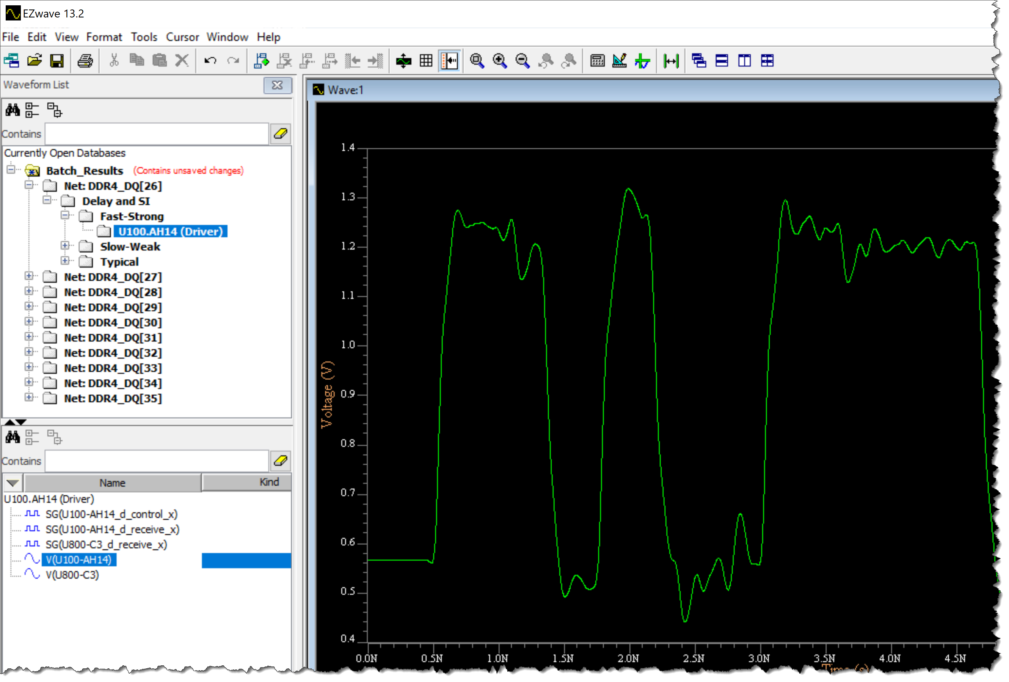
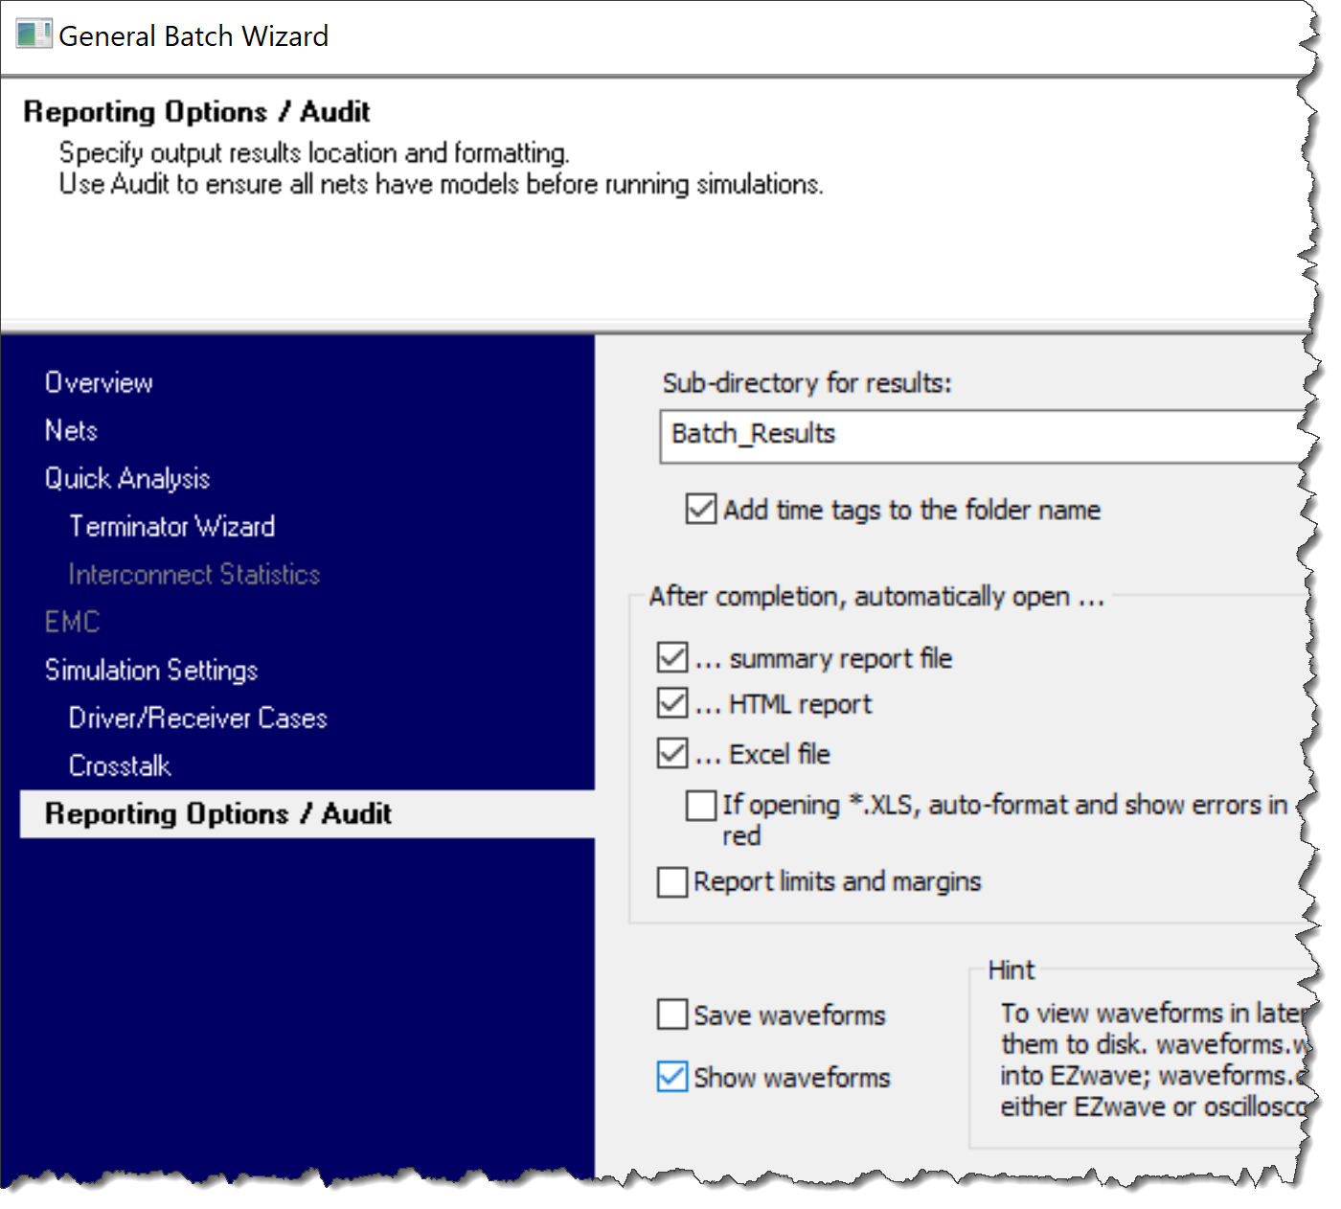
General Batch Wizard
Quick Analysis
SI Analysis (timing, SI, crosstalk)
EMC Analysis

Slide 19
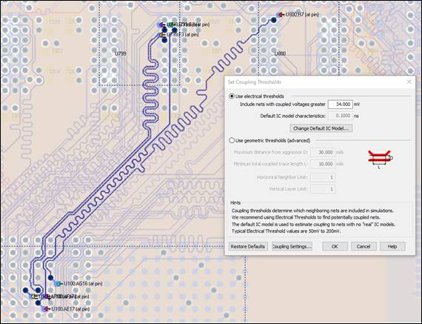
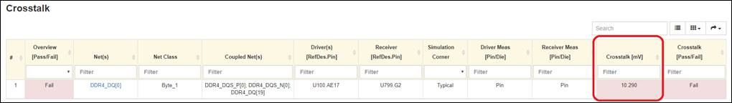
Summary
Crosstalk

Slide 20
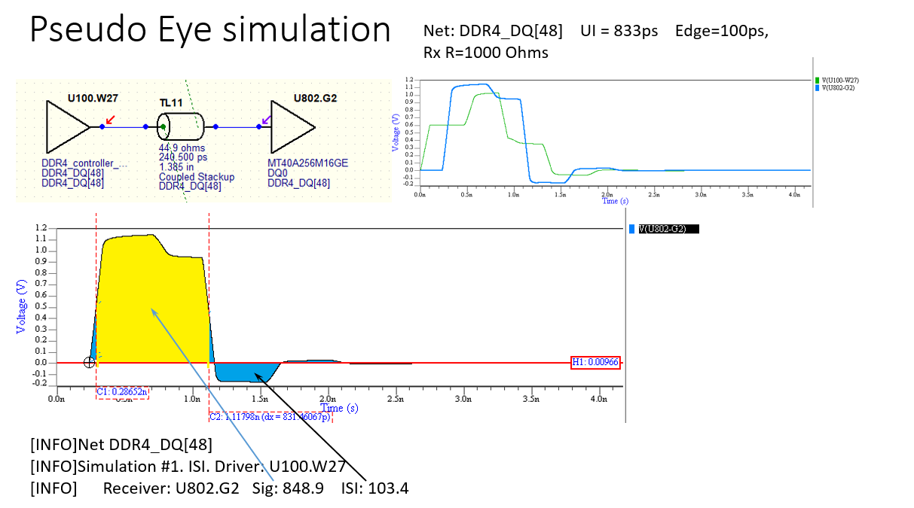
Summary

Slide 21
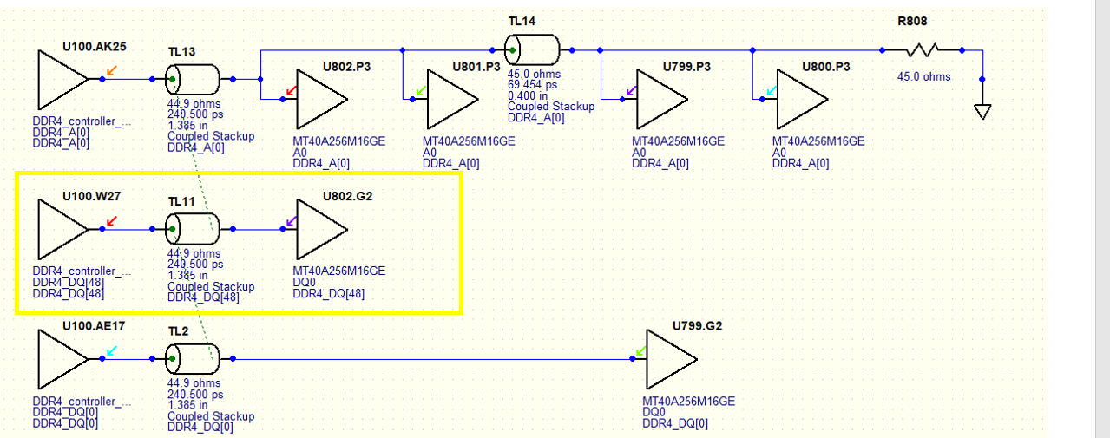
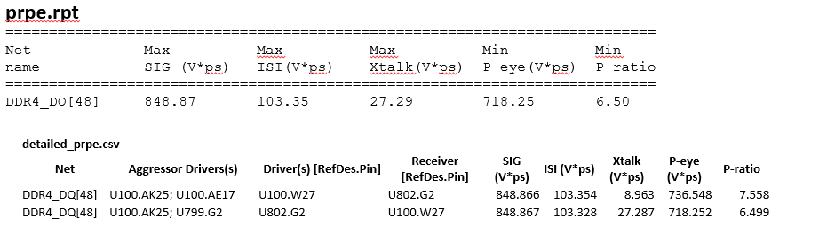
Pulse Respone Wizard

Slide 22
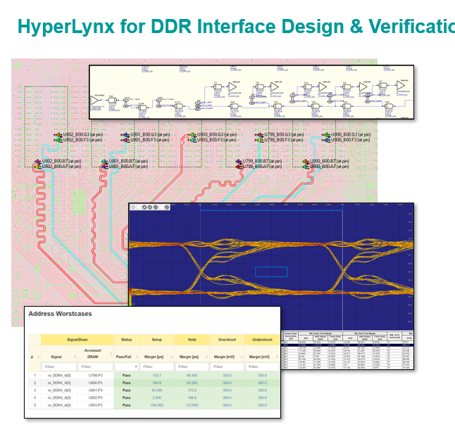
Summary

Slide 23
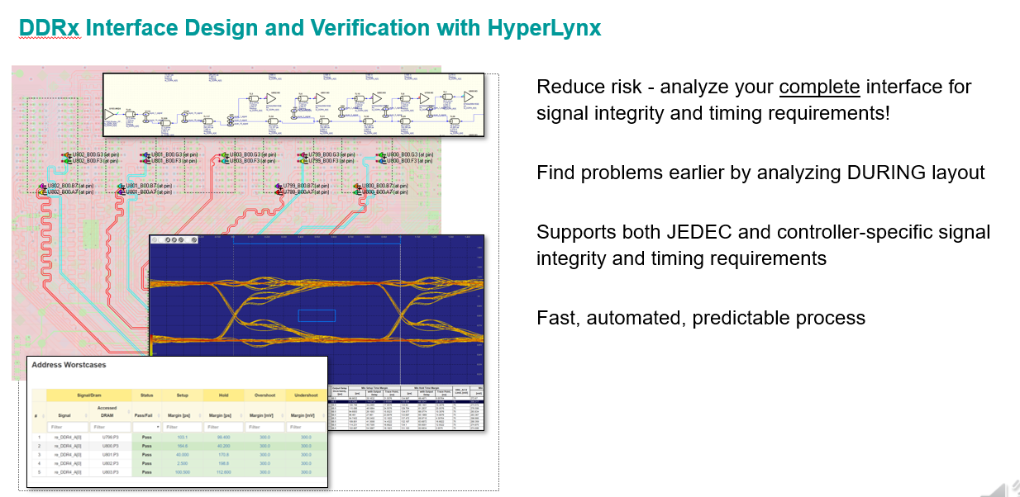
Summary

Slide 24
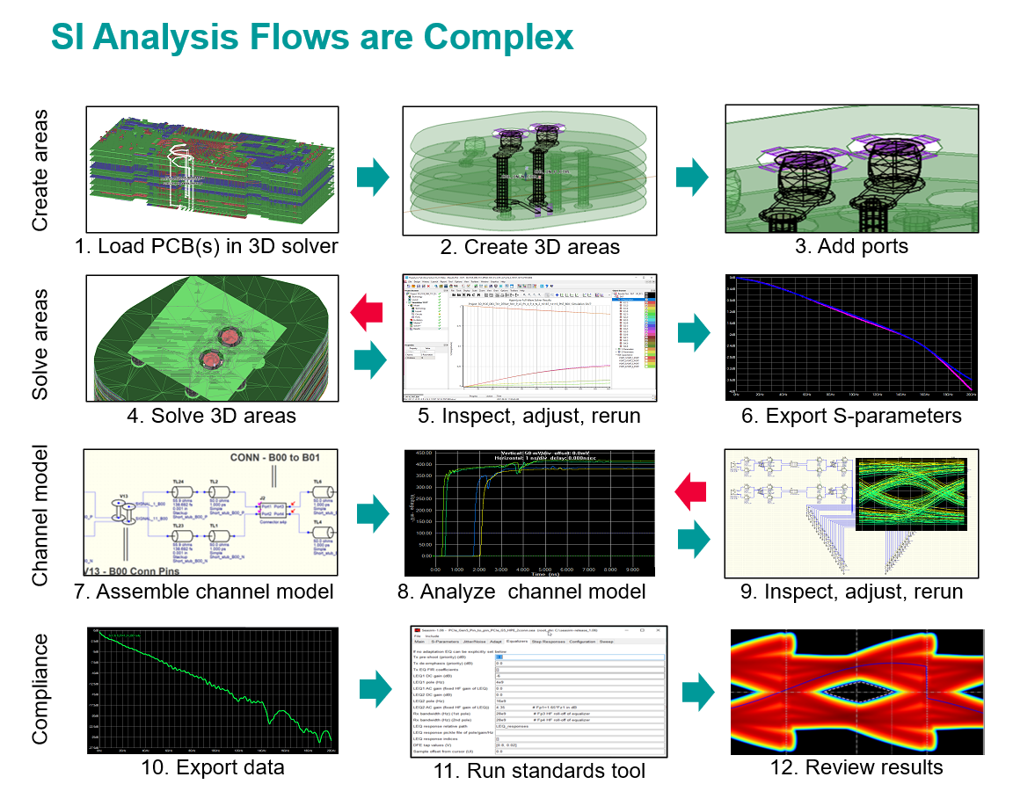
Summary

Slide 25
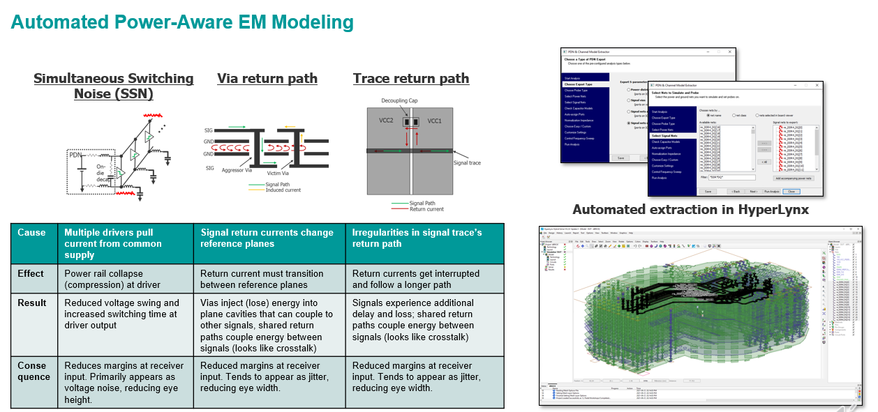
Summary

Slide 26
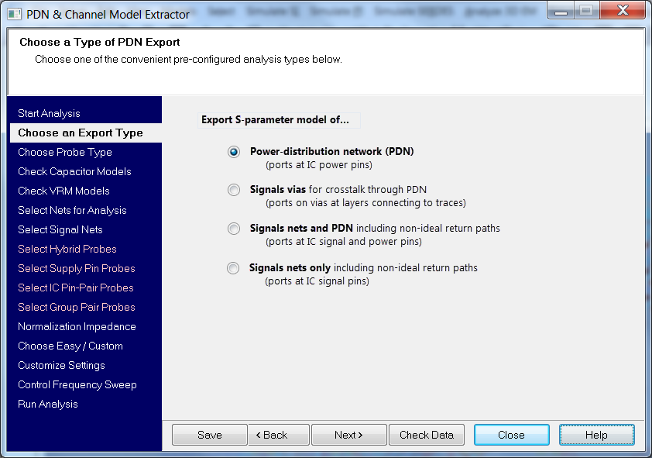
Summary

Slide 27
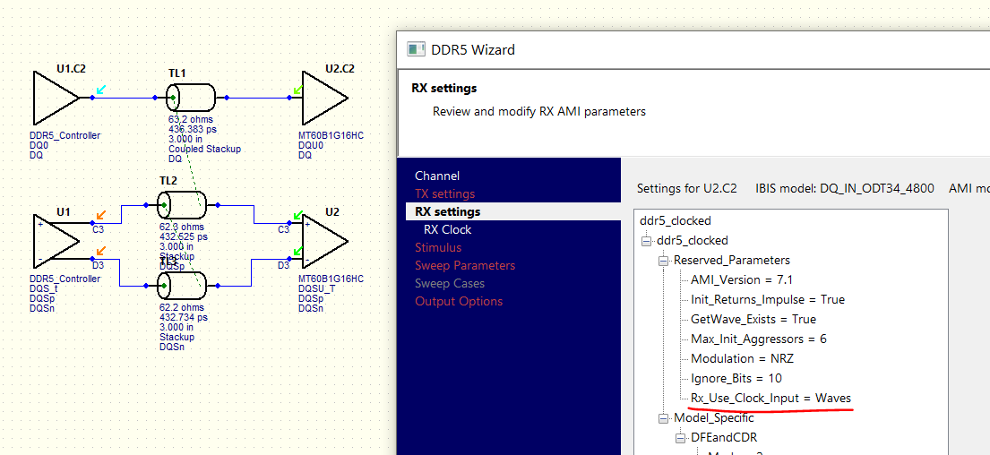
Interactive DDR5 simulation

Slide 28
Summary

Slide 29
Summary

Slide 30
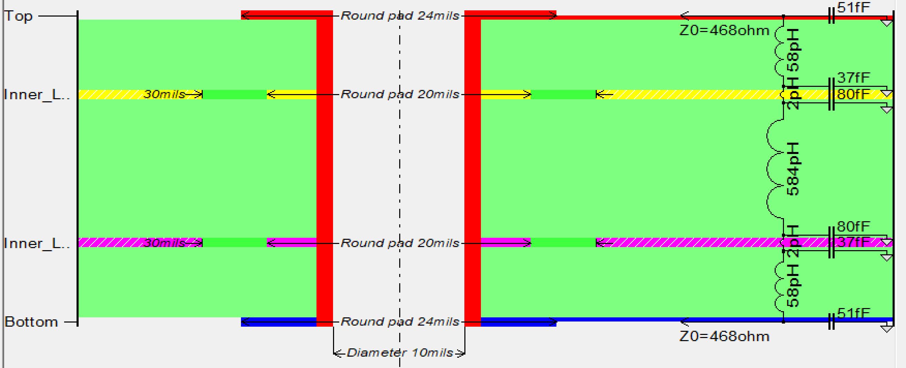
Via model in HyperLynx SI/PI
Via model in HL SI/PI is not power aware. But it attempts to estimate the effect of the return current transition between the planes.
If we inspect the via equivalent circuit in HL SI/PI we can find the large inductance between the plane layers. This one estimates the return current transition effect.
This inductance estimates the effect of the return current transition between the planes

Slide 31
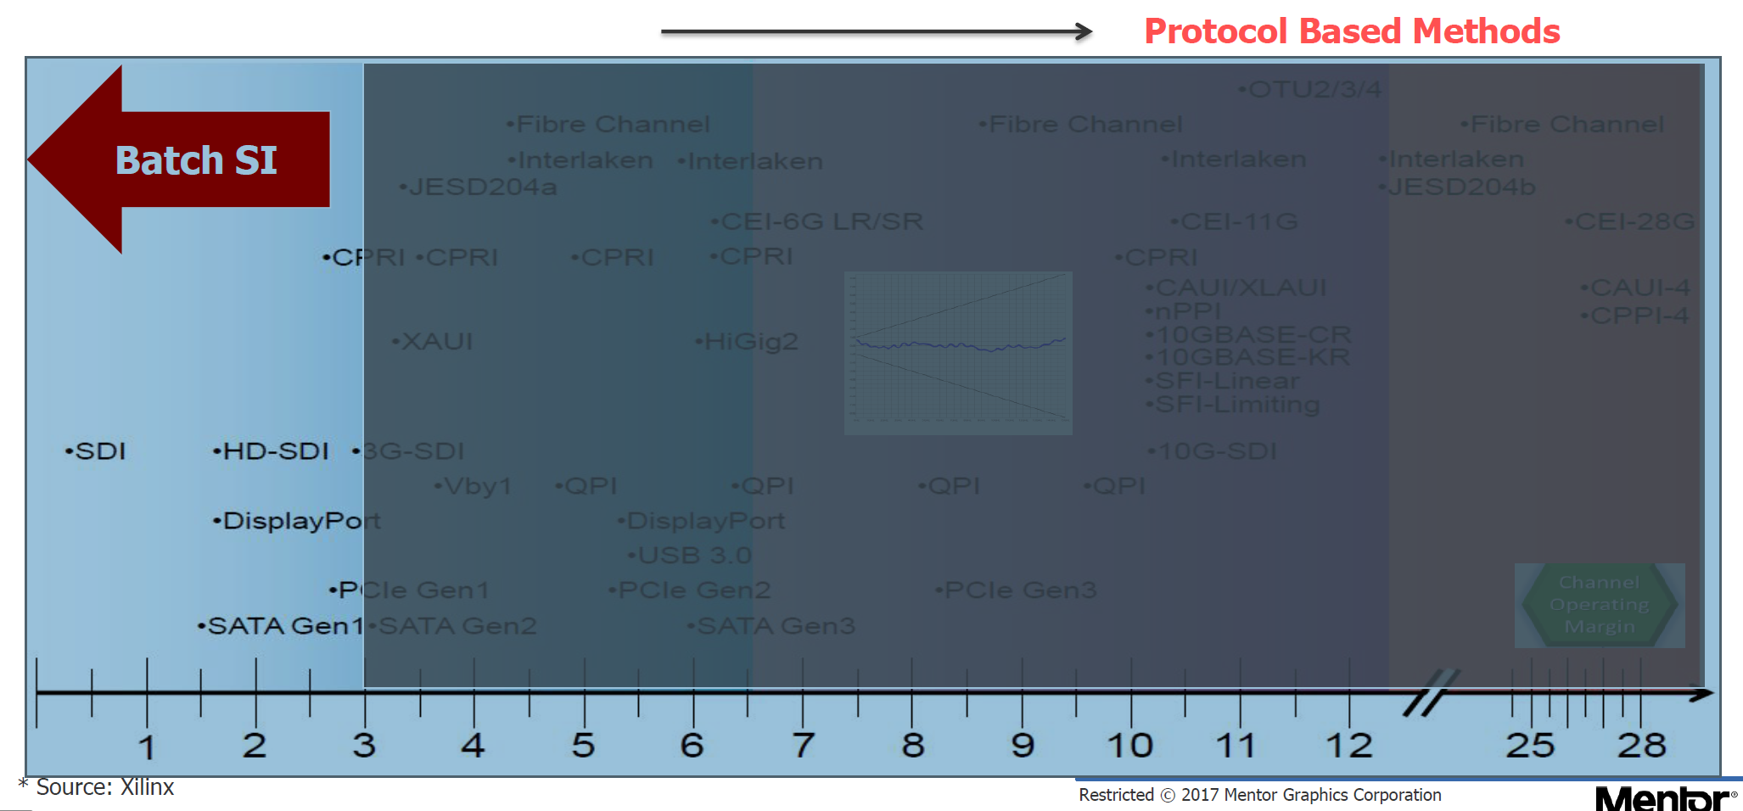
Summary

Slide 32
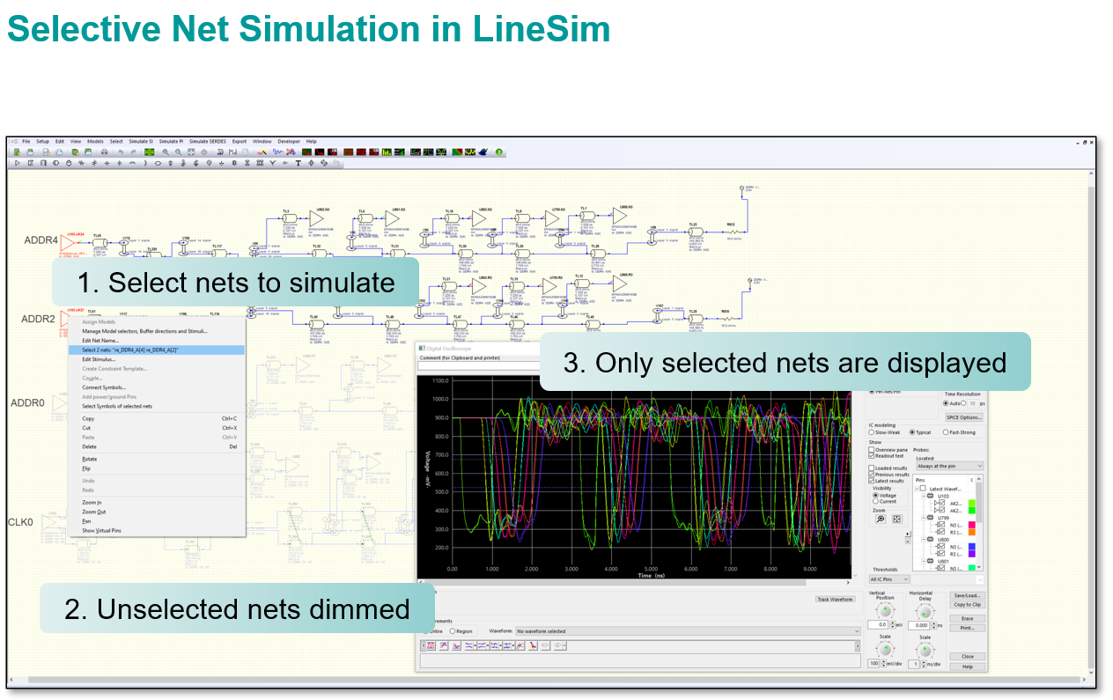
Summary

Slide 33
Summary

Slide 34
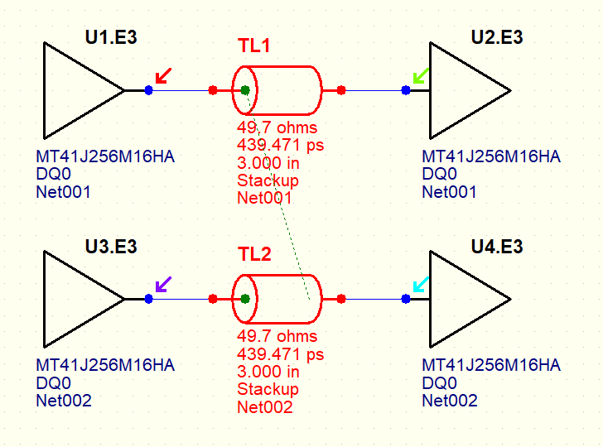
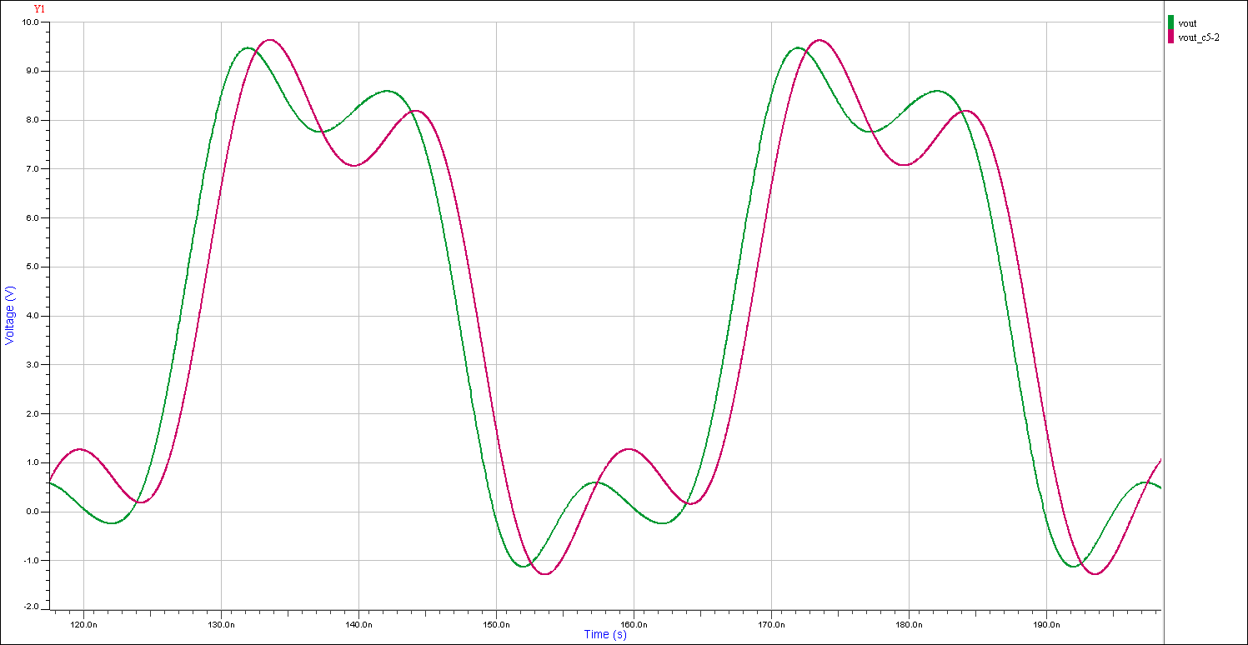
Empty page

Slide 35
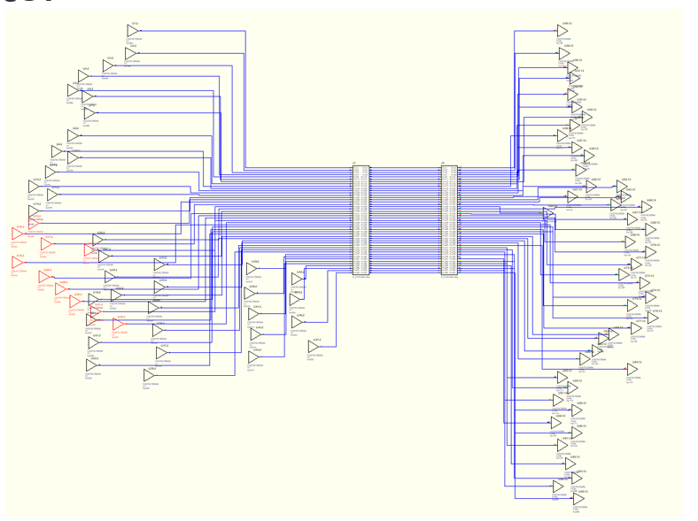
Summary

Slide 36
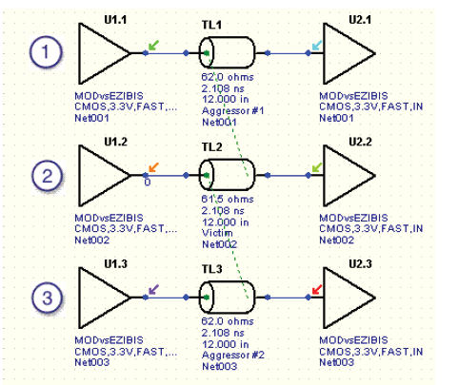
Summary

Slide 37
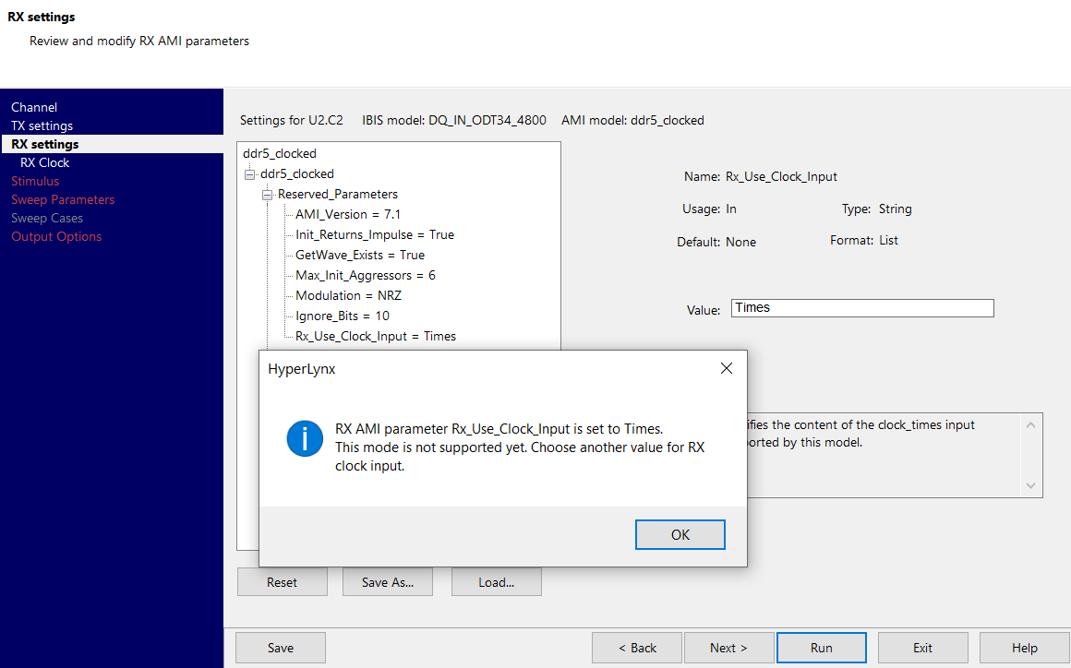
Summary

Slide 38
Summary

Slide 39
Summary

Slide 40
Summary

